Slide 1










COMPLETE GUIDE TO ASP.NET CORE MVC

Slide 2
TOPICS COVERED
CRUD OPERATIONS
Entity Framework Core
Fundamentals of ASP.NET Core
Client & Server Validations
CHANGES IN .NET 6
DEPLOY TO AZURE
TempData
ERROR SOLVING

Slide 3
Projects
CRUD MVC
CRUD Razor Pages
MVC - ECommerce

Slide 4
Prerequisites
C# (Basics)
SQL
(Basics)

Slide 5
Course Overview
N-Tier Architecture
Repository Pattern and UnitOfWork
TempData/ViewBag/ViewData in .NET core
API Controllers with Razor Pages
SweetAlerts, Rich Text Editor and DataTables with .NET Core
Scaffold Identity (Razor Class Library)
Roles and Authorization in .NET Core
Stripe Payment/Refund with .NET Core
Session in .NET Core
Emails with SMTP and SendGrid
Social Login using Facebook
View Components in .NET Core
Seed Database with DbInitializer
Deploy to Azure

Slide 6
TOPICS COVERED
Entity Framework Core
CRUD OPERATIONS
Fundamentals of ASP.NET Core
EMAIL TEMPLATES
SESSION, VIEWDATA, VIEWBAG, VALIDATIONS
ADD IDENTITY TO PROJECT
ASSIGNMENTS , ERROR SOLVING

Slide 7
TOPICS COVERED
CRUD OPERATIONS
Entity Framework Core
Fundamentals of ASP.NET Core
Client & Server Validations
CHANGES IN .NET 6
DEPLOY TO AZURE
TempData
ERROR SOLVING

Slide 8
TOOLS NEEDED
.NET 6
VISUAL STUDIO 2022
SSMS 2018

Slide 9
.NET CORE ROADMAP
.NET CORE
1.0
2.0
3.0
3.1
.NET CORE
.NET CORE
.NET CORE
.NET CORE
.NET CORE
5.0
6.0
June 2016
Aug 2018
Sept 2019
Dec 2019
Nov 2020
Nov 2021

Slide 10
BUILT IN DEPENDENCY INJECTION
CROSS PLATFORM
EASY UPDATES
ASP.NET CORE
FAST AND OPEN SOURCE
CLOUD FRIENDLY
PERFORMANCE

Slide 11
DEPENDENCY INJECTION

Slide 12



WITHOUT DEPENDENCY INJECTION
Page 1
Db dbObj = new Db()
Email
Email emailObj = new Email()
Page 2
Email emailObj = new Email()
Db dbObj = new Db()
Page 3
Database
Email emailObj = new Email()
Db dbObj = new Db()

Slide 13
WITH DEPENDENCY INJECTION
Page 1
IDb
Email
IEmail
IEmail,Email
IEmail
Page 2
DI
CONTAINER
IDb
IDb,Db
Page 3
IEmail
Database
IDb

Slide 14



.NET CORE PIPELINE
Request from Browser
Auth
MVC
Static Files

Slide 15
ASSIGNMENT - 1
Create Cover Type Model / Table
Id
Name
Push Cover Type to Database
Implement CoverType Repository and perform CRUD operations using UnitOfWork.

Slide 16
ASSIGNMENT - 2
Create Cover Type Controller & Action Methods (Create/Edit/Delete/Index)
Create Views for Create/Edit/Delete/Index
Add Client Side and Server-Side Validations.

Slide 17
ASSIGNMENT - 3
Create Company Model / Table
Id [Key]
Name [Required]
StreetAddress
City
State
PostalCode
PhoneNumber
Add Company to Repository and UnitOfWork
Perform CRUD Operations on Company (using DataTables)

Slide 18
ASSIGNMENT
Add logic to remove item from shopping cart.
Add logic to decrement count in shopping cart for item. (If count is 1 then you will have to remove)

Slide 19
ASSIGNMENT
Add OrderHeader and OrderDetails to Database
Add Order Header and Details Repository and Configure UnitOfWork (With Update method)

Slide 20
ASSIGNMENT
Create a new Folder in Pages – Order
In that new folder create new Razor Page – OrderList
Create OrderController and its GET Method should only be invoked by authorized user.
GET Method in controller should return all OrderHeaders.

Slide 21
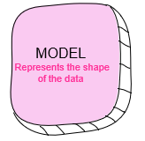
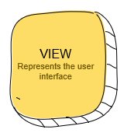
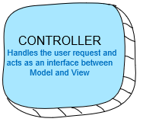
MVC ARCHITECTURE
2. Get Data
3. Get Presentation
USER CLICKS
1. Request
4. Response

Slide 22
ROUTING IN MVC
The URL pattern for routing is considered after the domain name.
https://localhost:55555/Category/Index/3
https://localhost:55555/{controller}/{action}/{id}
URL | Controller | Action | Id
https://localhost:55555/Category/Index | Category | Index | Null
https://localhost:55555/Category | Category | Index | Null
https://localhost:55555/Category/Edit/3 | Category | Edit | 3
https://localhost:55555/Product/Details/3 | Product | Details | 3

Slide 23
ENDPOINTS
https://localhost:1234/Home/Index
/{controller}/{action}
MVC
https://localhost:1234/Home/Login
RAZOR PAGES
https://localhost:1234/Hub/Pop
SIGNALR

Slide 24
.NET CORE PIPELINE
Request from Browser
UseRouting
MVC
Static Files

Slide 25
APPSETTINGS.JSON
All of the application’s settings are contained in a file named as appsettings.json
Any changes to the appsettings.json file will require restarting the “Microsoft IIS Administration” service to take effect.

Slide 26
TAG HELPERS
Tag Helpers are introduced with ASP.NET Core
Tag Helpers enable server-side code to participate in creating and rendering HTML elements in Razor files.
Tag helpers are a new feature and similar to HTML helpers, which help us render HTML.
They are more focused around HTML tags and much more easier to use with HTML.

Slide 27
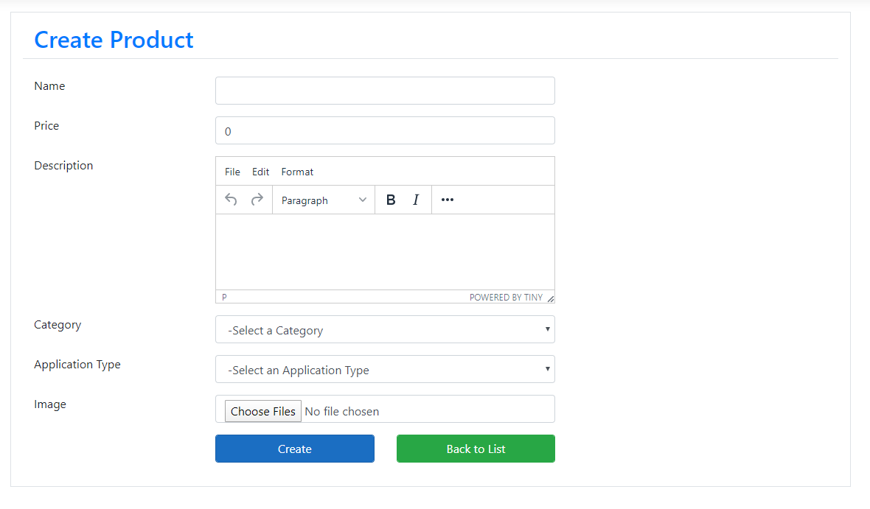
PRODUCT
CATEGORY
APPLICATIONTYPE

Slide 28
Tag Helpers
Tag Helpers are introduced with ASP.NET Core.
Tag Helpers enable server-side code to participate in creating and rendering HTML elements in Razor files.
Tag Helpers are very focused around the html elements and much more natural to use.

Slide 29
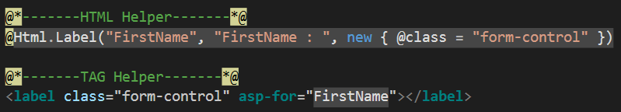
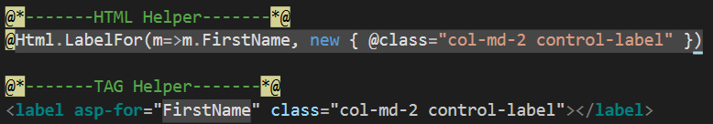
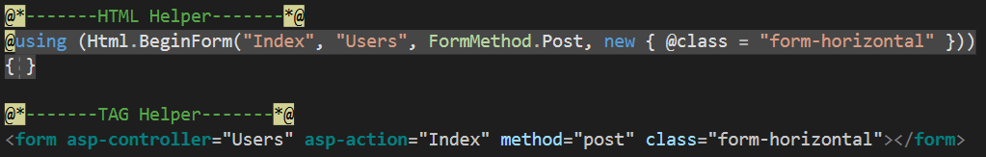
Tag Helpers Example

Slide 30
Razor Pages
Introduced in asp.net core 2.0
Razor Pages is a new feature of ASP.NET Core MVC that makes coding page-focused scenarios easier and more productive
Razor pages is not just for simple scenarios, everything that you can do with MVC you can do by using Razor pages like Routing, Models, ActionResult, Tag Helpers and so on.

Slide 31

Routing in Razor Pages
Routing in Asp.net Razor pages maps URL’s to Physical file on disk.
Razor pages needs a root folder.
Index.cshtml is a default document
URL | Maps To
www.domain.com | /Pages/Index.cshtml
www.domain.com/index | /Pages/Index.cshtml
www.domain.com/account | /Pages/account.cshtml /Pages/account/index.cshtml

Slide 32
Action Result
ActionResult is a result of action methods/pages or return types of action methods/page handlers
Action result is a parent class for many of the derived classes that have associated helpers.
The IActionResult return type is appropriate when multiple ActionResult return types are possible in an action.

Slide 33
Action Result in Razor Pages
ActionResult | Helper | Description
ContentResult | Content | Takes a string and returns it with a text/plaincontent-type header by default. Overloads enable you to specify the content-type to return other formats such as text/html or application/json, for example.
FileContentResult | File | Returns a file from a byte array, stream or virtual path.
NotFoundResult | NotFound | Returns an HTTP 404 (Not Found) status code indicating that the requested resource could not be found.
PageResult | Page | Will process and return the result of the current page.
PartialResult | Partial² | Returns a Partial Page.
RedirectToPageResult | RedirectToPage RedirectToPagePermanent RedirectToPagePreserveMethod RedirectToPagePreserveMethodPermanent | Redirects the user to the specified page.
ViewComponentResult |  | Returns the result of executing a ViewComponent.

Slide 34
Action Result in MVC
Action Result | Helper Method | Description
ViewResult | View | Renders a view as a Web page.
PartialViewResult | PartialView | Renders a partial view, which defines a section of a view that can be rendered inside another view.
RedirectResult | Redirect | Redirects to another action method by using its URL.
RedirectToRouteResult | RedirectToAction RedirectToRoute | Redirects to another action method.
ContentResult | Content | Returns a user-defined content type.
JsonResult | Json | Returns a serialized JSON object.
JavaScriptResult | JavaScript | Returns a script that can be executed on the client.
FileResult | File | Returns binary output to write to the response.
EmptyResult | (None) | Represents a return value that is used if the action method must return a null result (void).

Slide 35
PRODUCT
CATEGORY
APPLICATIONTYPE

Slide 36
VIEWBAG
VIEWDATA
TEMPDATA
ViewBag transfers data from the Controller to View, not vice-versa. Ideal for situations in which the temporary data is not in a model.
ViewBag is a dynamic property that takes advantage of the new dynamic features in C# 4.0
Any number of properties and values can be assigned to ViewBag
The ViewBag's life only lasts during the current http request. ViewBag values will be null if redirection occurs.
ViewBag is actually a wrapper around ViewData.
ViewData transfers data from the Controller to View, not vice-versa. Ideal for situations in which the temporary data is not in a model.
ViewData is derived from ViewDataDictionary which is a dictionary type.
ViewData value must be type cast before use.
The ViewData's life only lasts during the current http request. ViewData values will be null if redirection occurs.
TempData can be used to store data between two consecutive requests.
TempData internaly use Session to store the data. So think of it as a short lived session.
TempData value must be type cast before use. Check for null values to avoid runtime error.
TempData can be used to store only one time messages like error messages, validation messages.
ViewBag internally inserts data into ViewData dictionary. So the key of ViewData and property of ViewBag must NOT match

Slide 37
STRONGLY TYPED VIEWS

Slide 38
VIEWMODELS

Slide 39
ASSIGNMENT
Add Application Type to Product Model.
Add that in all CRUD operations of Product as well

Slide 40
Pending
ORDER STATUS MANAGMENT
Submitted
In Process
Automatic /
Payment Successful
When order is
being cooked
When order is
Ready for Pickup
Ready for Pickup
When order is
Picked Up.
Completed
KITCHEN
MANAGER
KITCHEN
MANAGER
FRONT DESK
MANAGER
Submitted
In Process
FRONT DESK
MANAGER
Cancel or Refund order
Manage Order
Refund / Cancel
Ready For Pickup
Completed
Cancelled
Order List

Slide 41

ORDER STATUS MANAGMENT
Makes Payment
Order Confirmation
Processing
Shipped
Individual
Customer
Status - Pending
Payment - Pending
Status - Approved
Payment - Approved
Status - Processing
Payment - Approved
Status - Shipped
Payment - Approved

Slide 42
ORDER STATUS MANAGMENT
Makes Payment
Order Confirmation
Processing
Shipped
Customer
Status - Pending
Payment - Pending
Status - Approved
Payment - Approved
Status - Processing
Payment - Approved
Status - Shipped
Payment - Approved
Order Confirmation
Processing
Makes
Payment
Shipped
Company have 30days
to make payment
after order is shipped
Company
Status - Approved
Payment - ApprovedForDelayedPayment
Status - Processing
Payment - ApprovedForDelayedPayment
Status - Shipped
Payment - ApprovedForDelayedPayment
Status - Shipped
Payment - Approved

Slide 43
VIEWMODEL
ViewModel contain fields that are represented in the view
ViewModel can have specific validation rules using data annotations.
ViewModel can have multiple entities or objects from different data models or data source.
ViewModel helps to implement strongly typed views.

Slide 44
VIEWBAG
ViewBag transfers data from the Controller to View, not vice-versa. Ideal for situations in which the temporary data is not in a model.
ViewBag is a dynamic property that takes advantage of the new dynamic features in C# 4.0
Any number of properties and values can be assigned to ViewBag
The ViewBag's life only lasts during the current http request. ViewBag values will be null if redirection occurs.
ViewBag is actually a wrapper around ViewData.
ViewData transfers data from the Controller to View, not vice-versa. Ideal for situations in which the temporary data is not in a model.
ViewData is derived from ViewDataDictionary which is a dictionary type.
ViewData value must be type cast before use.
The ViewData's life only lasts during the current http request. ViewBag values will be null if redirection occurs.
TempData can be used to store data between two consecutive requests.
TempData internaly use Session to store the data. So think of it as a short lived session.
TempData value must be type cast before use. Check for null values to avoid runtime error.
TempData can be used to store only one time messages like error messages, validation messages.
ViewBag internally inserts data into ViewData dictionary. So the key of ViewData and property of ViewBag must NOT match

